Slide 1

TECHTONIX SALES ANALYSIS
BY: IFUNANYA EMMANUELA OZOH
This Photo by Unknown Author is licensed under CC BY-ND

Slide 2
CASE OVERVIEW
Techtronix Innovations, a forefront player in the microchip and robotics industry, is encountering challenges in streamlining its sales strategies, optimizing production planning, and pursuing market expansion. The company boasts an extensive portfolio that caters to automotive, consumer electronics, and industrial sectors. However, it grapples with demand unpredictability, inventory management inefficiencies, and the identification of profitable market opportunities.
Over the previous year, Techtronix Innovations has meticulously compiled a dataset encompassing each transaction, encompassing sales data, customer interactions, product specifics, and financial metrics. This dataset presents an invaluable opportunity for in-depth business performance analysis, trend identification, and insight extraction to inform strategic decisions.

Slide 3
AIMS AND OBJECTIVES
Utilizing the dataset to guide Techtronix Innovations in overcoming its current obstacles through the creation of an automated Power BI
report. This report will focus on:
Sales Performance Analysis: Uncover sales trends across various product categories, sectors, regions, and timeframes. Highlight the best and worst performers.
Customer Insights: Dive into customer segmentation to reveal purchase patterns, preferences by sector, and geographic distribution. Identify the sectors contributing most significantly to sales and profitability.
Inventory Optimization: Evaluate inventory management against sales figures to pinpoint production planning mismatches. Propose methods to better align production with market demands.
Profitability Analysis: Analyze the profitability across different product categories, taking into account sales revenue and production costs. Point out products with high margins and suggest cost reduction strategies.
Market Expansion Opportunities: Analyze sales and customer data to discover new markets for expansion, emphasizing regions and sectors with untapped potential.

Slide 4
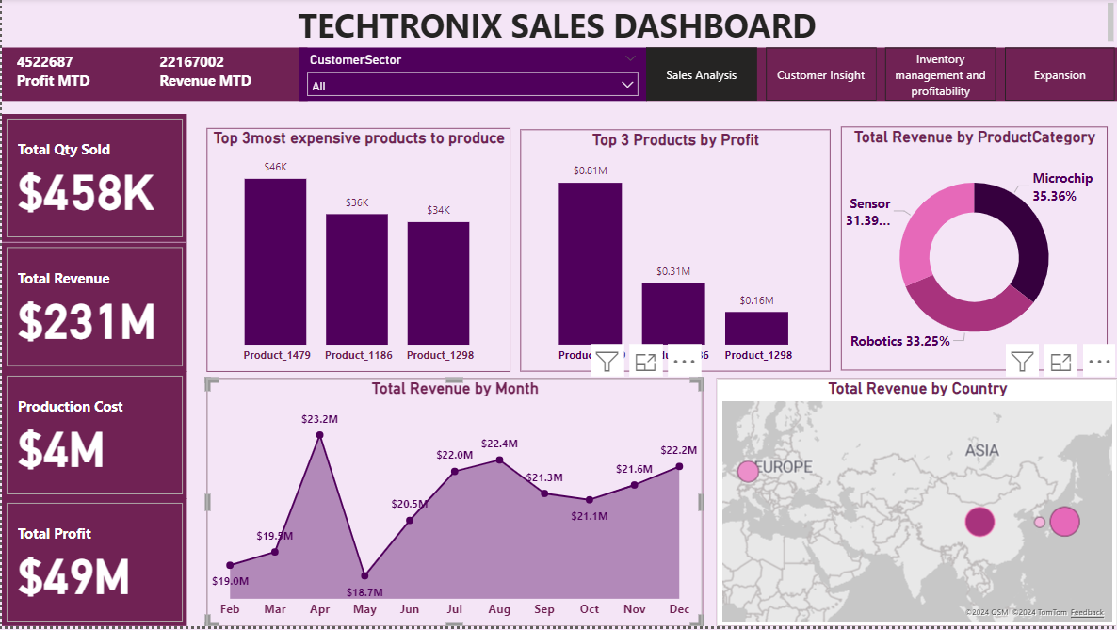

Slide 5
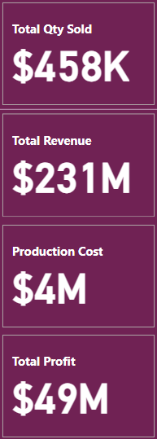
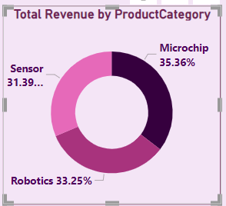
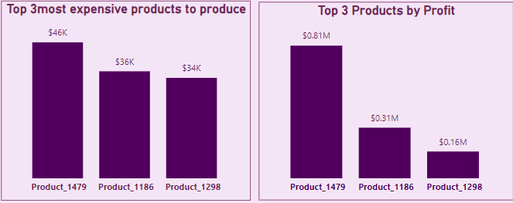
SALES PERFOMANCE ANALYSIS
The chart shows the top 3 products , product_1315 has 38k production cost with a profit of 45.2%, while product_1469 with $38k but has as profit of32.7%, product_1100 has the highest production cost of 48k but has a significantly low profit of 22%.
From the product Category , Microchip has the highest revenue at 38.6% and it has the highest profit with 39.55% followed by Robotics.

Slide 6
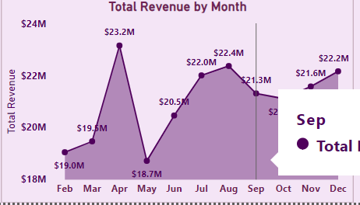
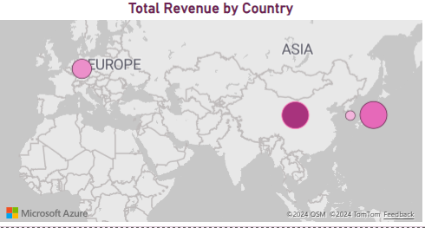
SALES PERFOMANCE ANALYSIS
In the Revenue chart, the highest revenue of $23.2M was generated in April with 9.2%. And May being the least with $18.7M and 7.2%
USA had the highest total revenue of $52.1M, followed by China $51M, Japan $50.2M, Germany $49.7M and South Korea $49.2M

Slide 7
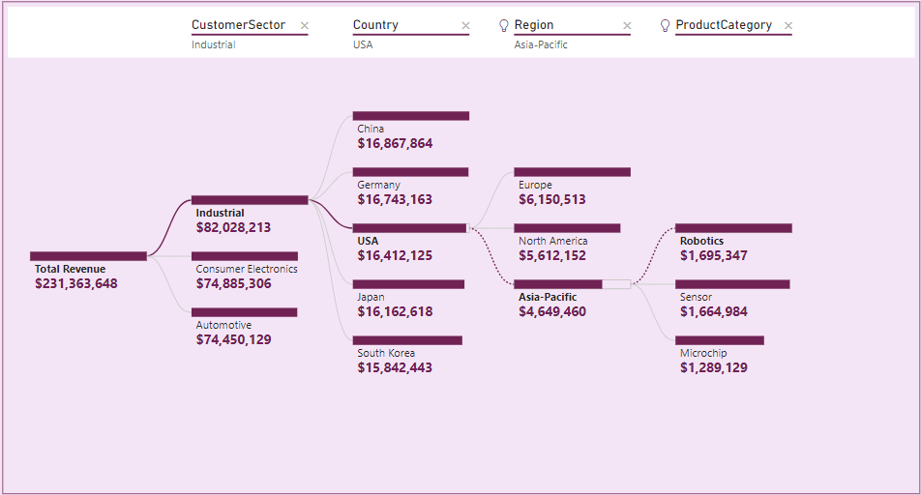
Customer Insight
Industrial has the highest customer sector with revenue of $82,028,213 while Automotive has the lowest with revenue of $74,450,129.
China had the highest revenue of $16,867,864 followed by Germany with $16,743,163 then South Korea has the lowest of $15,842,443.
Under Region, Europe topped the Chat with $6,150,513 while Asia pacific is the least with $4,649,460.
Under product category, robotics was the most sold product while Microchip had the lowest Revenue.

Slide 8
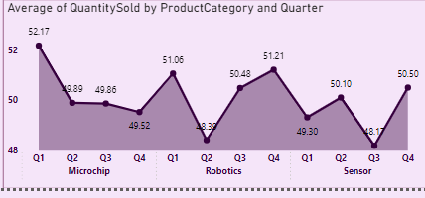
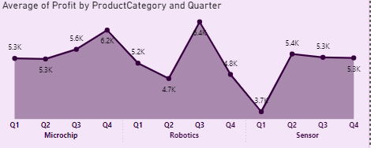
Inventory Optimization
All Product category has the highest quantity sold in Q1 and Q4, Microchip has the highest quantity 39% of product sold followed by Robotics 31.9% and Sensor 29.1%.
As seen in the chat each product category has different quarters when high profits were made. Robotics has the highest profit in Q3 with 6.4K followed by Microchip 6.2K in Q4 and the lowest Sensor 5.4K in Q2.

Slide 9
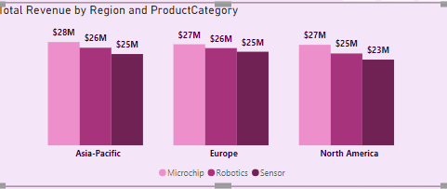
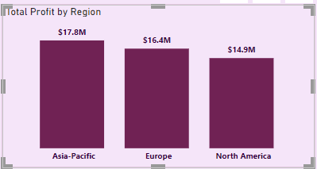
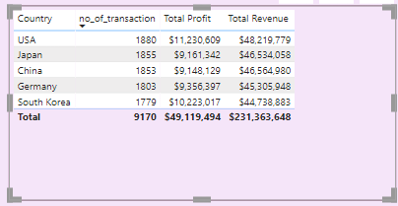
Market Expansion
Microchip has the highest total revenue across all regions while North America has the lowest total revenue in all the product categories.
Asia pacific has the highest total profit of $17.8M followed by Europe with the lowest being North America $14.9M
As seen in the Chart, USA has the
Highest No_of _transaction, Total
Profit and total revenue.

Slide 10
RECOMMENDATION
Increase investment in Microchip for Asia Pacific.
Invest more on products with higher margin and reduce investments on products with lower profit margin.
Discounts can be offered to regions and countries with medium sales to boost their sales and revenue generation.

Slide 11
Thank You

